Slide 1
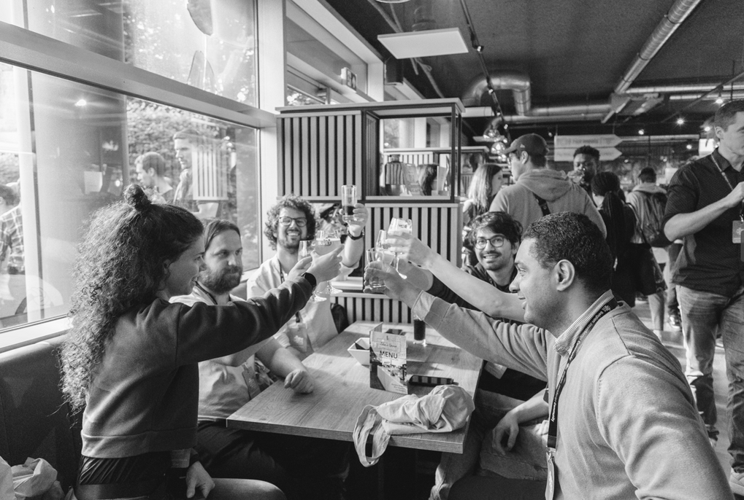
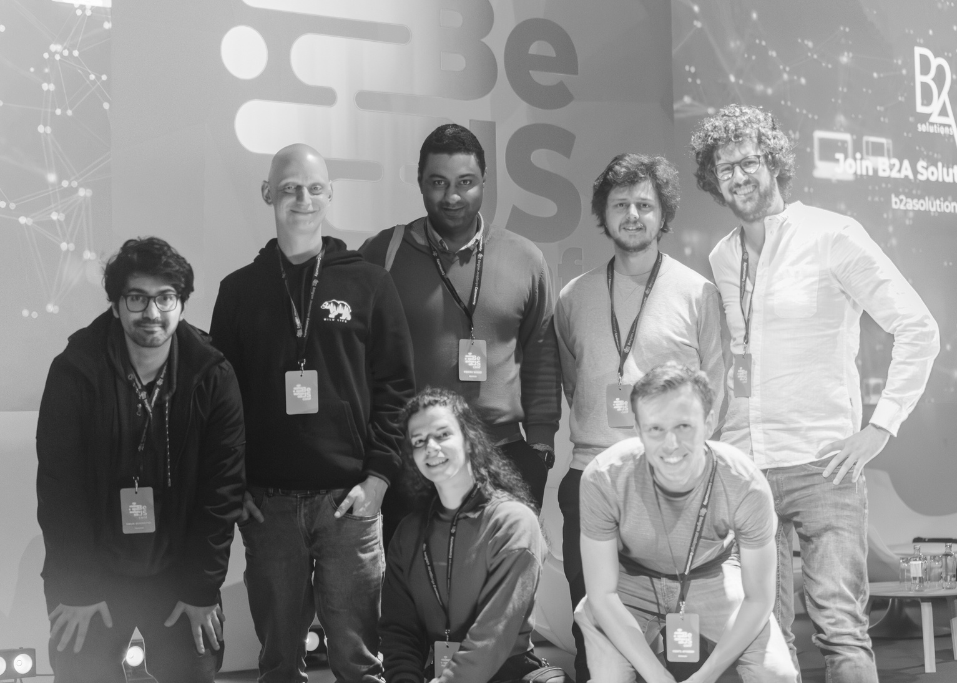
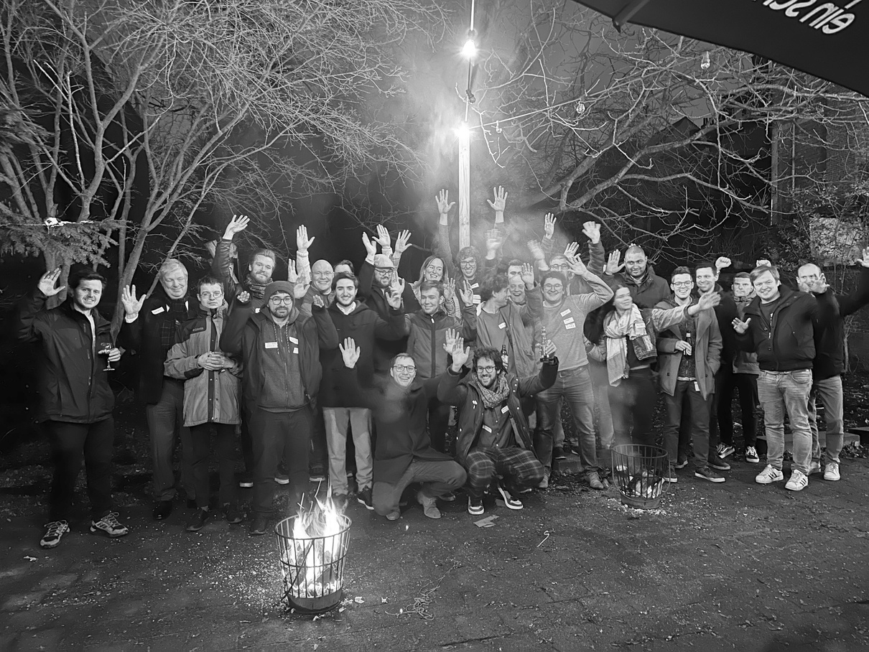


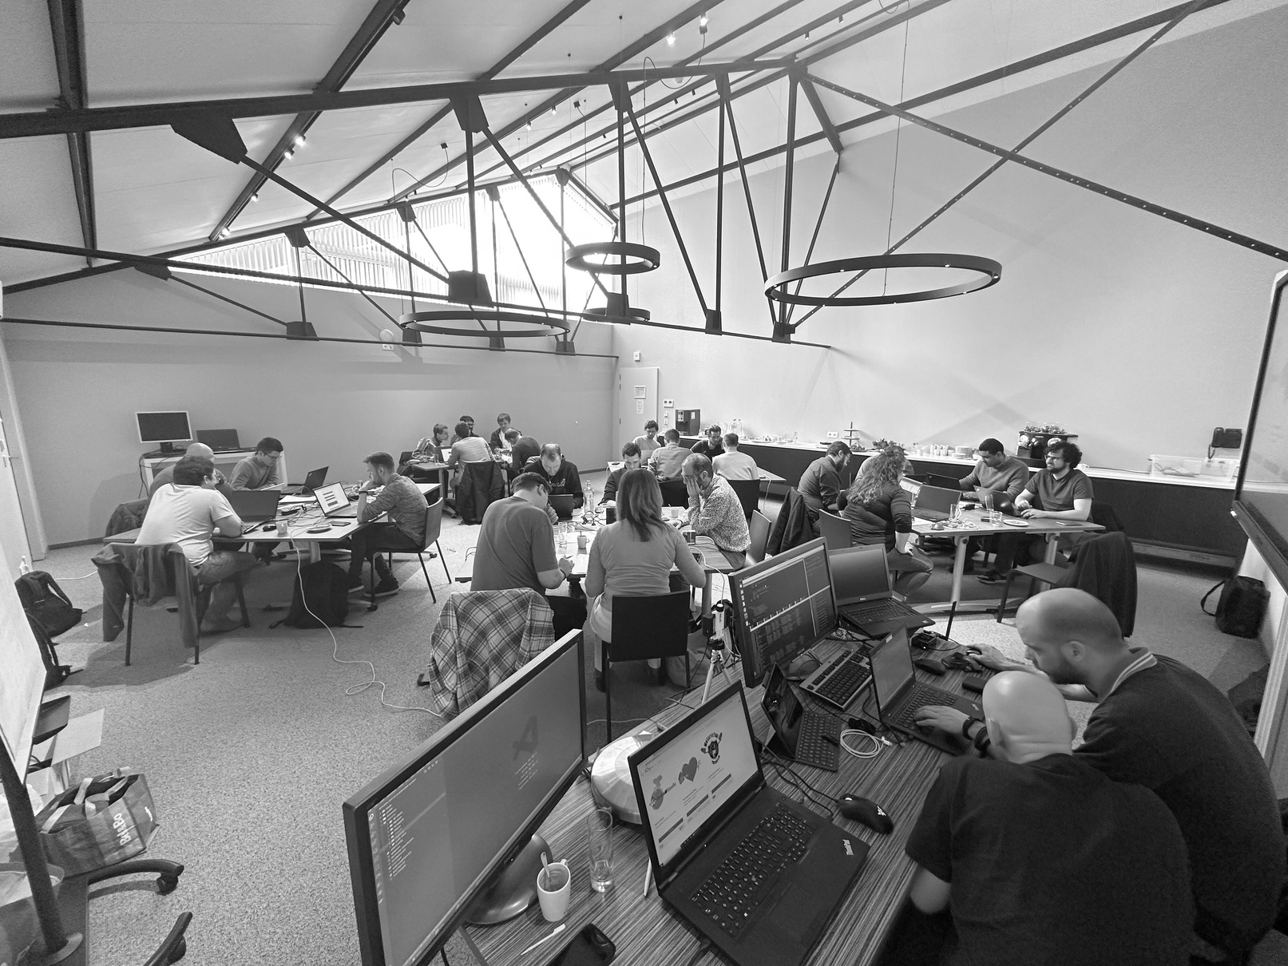

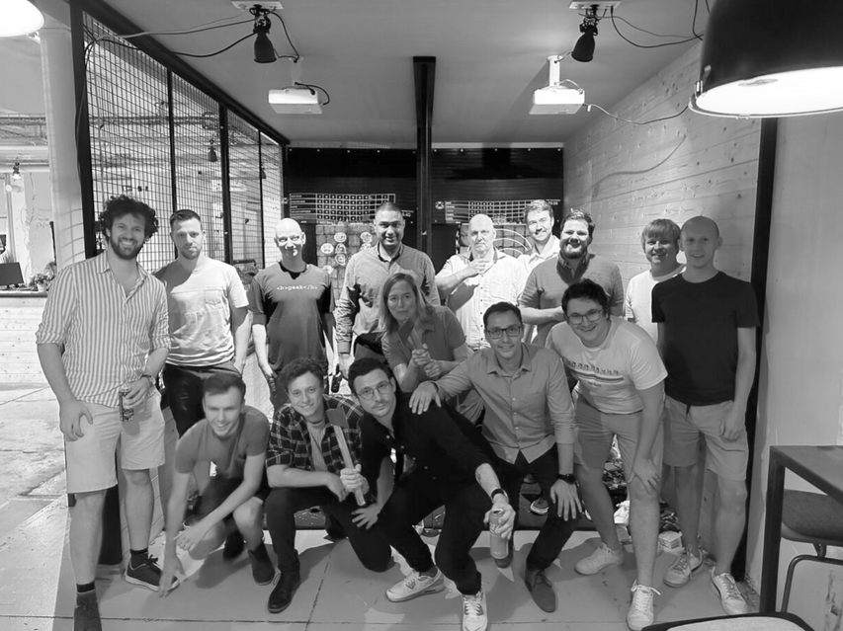


Internet of
Things
WOUTER VAN SCHANDEVIJL

Slide 2


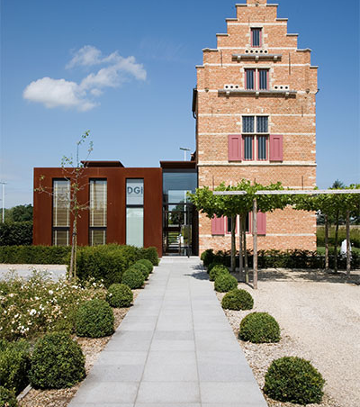


Menu
Home assistant
Intro
Integrations
Automation
Dashboards
Add-ons
ESPHome

Slide 3




Home assistant
Open-source smart home platform
Hub voor alle smart devices
Onafhankelijk van specifieke IoT ecosystemen
Local control
Geen coding skills vereist

Slide 4
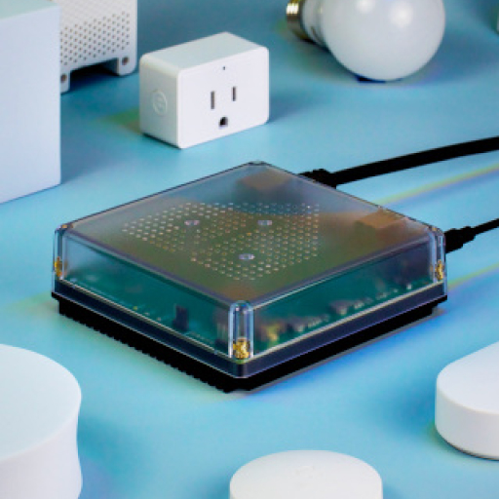
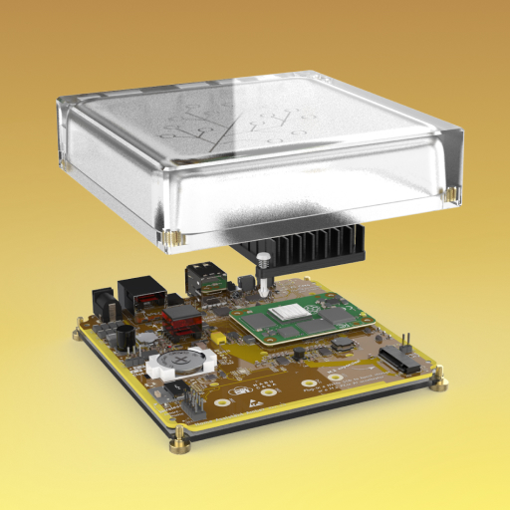
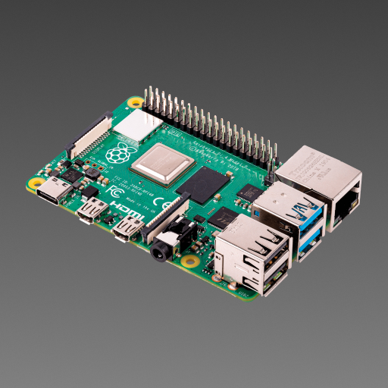
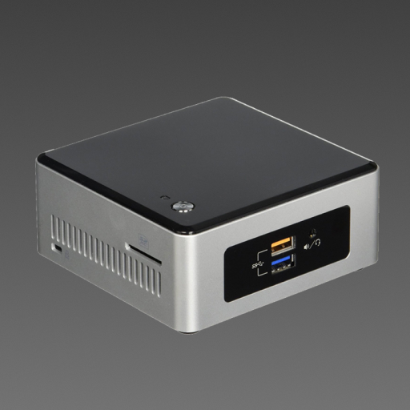
Home assistant

Slide 5
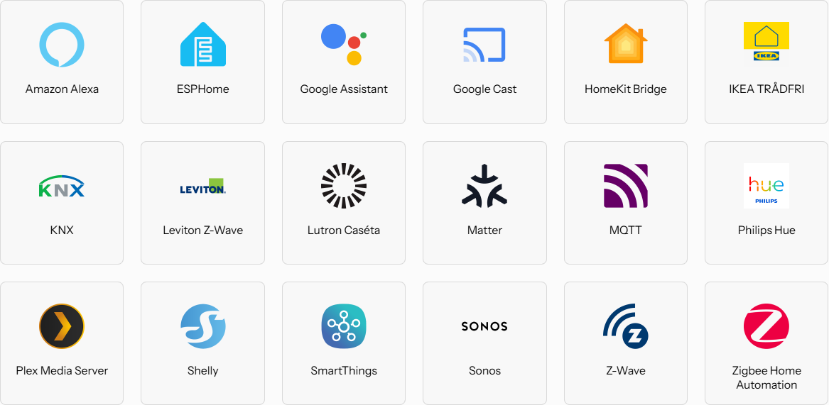
Integration
3071 Integrations

Slide 6

Integration
Home Assistant Community Store
Custom integrations
Platforms
Themes
Custom dashboard cards

Slide 7
Automation
Automations
Scrips
Scenes

Slide 8
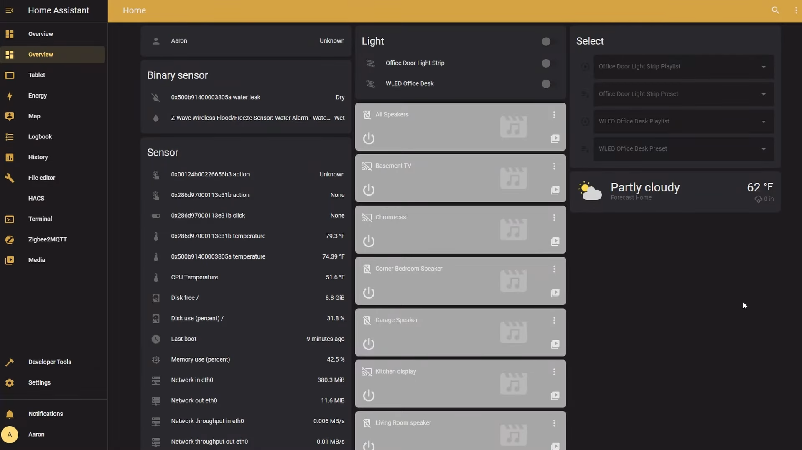
Dashboards
Default

Slide 9
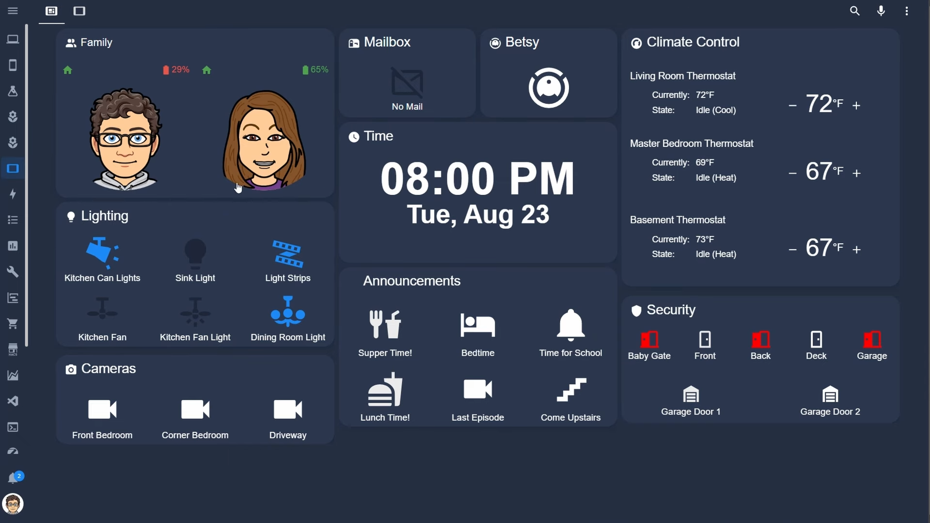
Dashboards
Custom

Slide 10
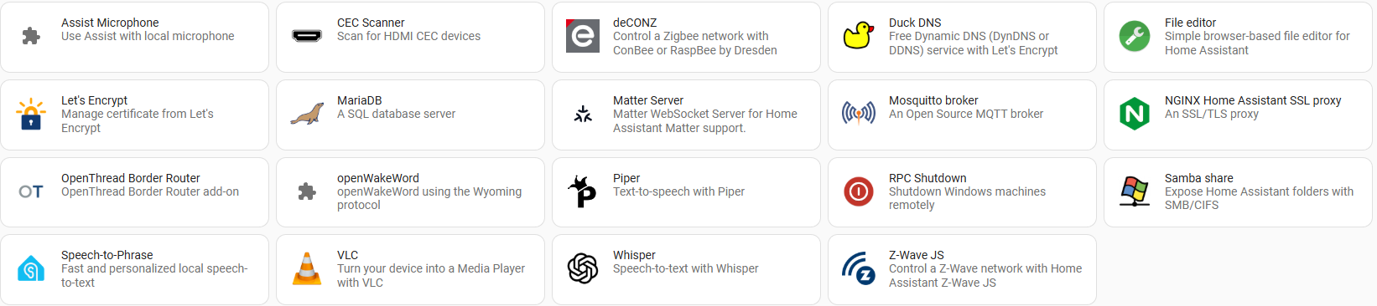
Add-ons
Service running alongside home assistant

Slide 11

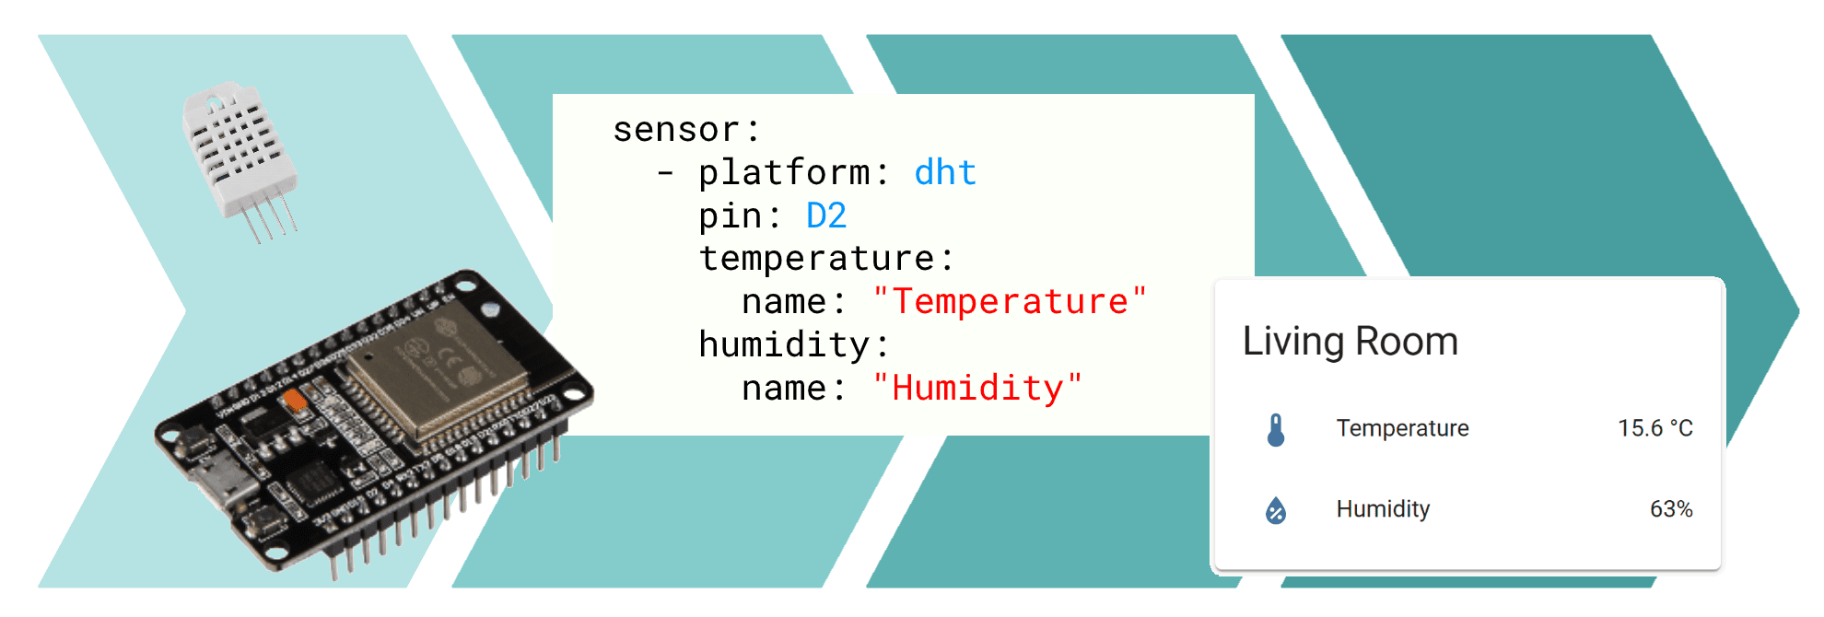
ESPHome

Slide 12




THANK YOU!

